Slide 1
GSA’s Vendor and Customer Self Service (VCSS)
Notes:
Hello and welcome to GSA’s Vendor and Customer Self Service (VCSS) training course. This course has been developed to walk you through the navigation and functionality of VCSS. You are listening to Segment 1, Introduction

Slide 2
Accounts Menu
Account Information or Account Search
If you have access to only one account, then the Account Information menu option displays. This will review general information of your account.
If you have access to more than one account, then the Account Search menu option displays. You can search for the account you would like to review information on.
Account Summary
Review balances for your accounts.
Outstanding Balances by Account
Review a list of outstanding balances for your accounts. (This page is the same as the home page).
Business Line Summary
Review account balances sorted by GSA business line (i.e. Rent and Fleet).
D1
Notes:
We are now going to walk through each of these Accounts menu bar options in this section.

Slide 3
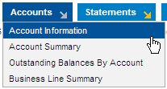
Account Information
The Account Information page is used to display your account information details.
If you have access to only one account, your account information automatically displays.
To access the Account Information page, from the menu bar select Accounts > Account Information.
Note: If you have access to more than one account, there is an extra step to search for an account first which is covered on the next slide
D2
Notes:
The Account Information option displays in your Accounts menu bar if you have access to one account.
Access the Account Information page from the menu bar.

Slide 4
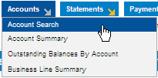
Account Search
The Account Search page is used to search for a list of your accounts.
If you have access to more than one account, you must first search for your accounts, and then select a specific account to view account information details.
To access the Account Search page, from the menu bar select Accounts > Account Search.
D3
Notes:
The Account Search option displays in your Accounts menu bar if you have access to more than one account.
Access the Account Search page from the menu bar.

Slide 5
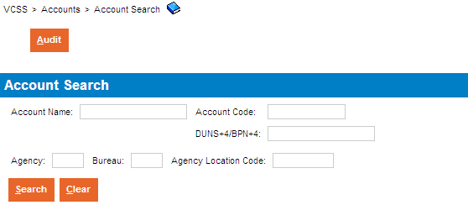
Account Search (Cont’d)
Account Search page
The Account Search page displays with a search criteria area to search for your accounts.
Select the [Search] button without entering search criteria.
If you have access to a large number of accounts, you may want to enter search criteria and select the [Search] button to limit the search results to a manageable number.
If you have access to a single account, you will see the Account Information page rather than the Account Search Page.
D4
Notes:
Here is the Account Search page. If you have access to only a few accounts, select [Search] without entering in any search criteria. This will display all of your account records in the search results.

Slide 6
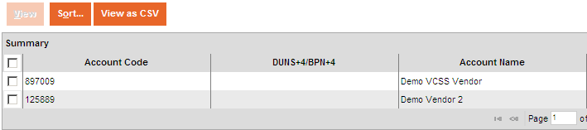
Account Search (Cont’d)
Account Search page
In the search results, review a list of accounts that met your search criteria. If you did not enter any search criteria, the list will show all of the accounts to which you have access.
D5
Notes:
This shows the results of your search, containing account records.

Slide 7
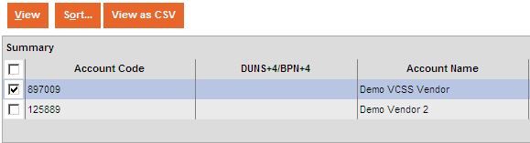
Account Search (Cont’d)
Account Search page
To view detailed information for an account record, in the search results select an account record and then select the [View] button.
D6
Notes:
View the account record details. From this page, here are the action buttons available for each account record. To open the account information, select a record and then select [View].

Slide 8
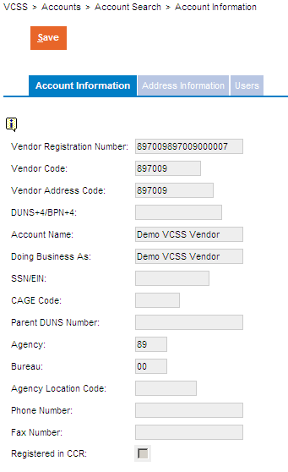
Account Information or Search
Account Record
If you have access to one account, when you select the Account Information option from the menu bar, your account record displays with detailed account information.
If you have access to more than one account, you must first search for your accounts, select a specific account record, and then select the [View] button to display your account record with detailed account information.
The account record opens and displays in a tab-like format. The first tab is the Account Information tab and contains general account information.
D7
Notes:
The account record displays after accessing the Account Search page to search for your account first, and then selected a record and selected the [View] button.
The account record also displays after accessing Account Information from the menu bar, if you have access to only one account.

Slide 9
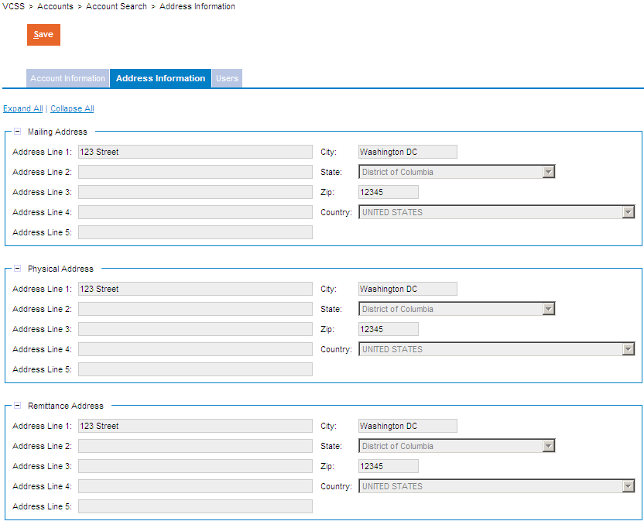
Account Information or Search (Cont’d)
Account Record
Within the account record, select the Address Information tab to review the mailing, physical, and remittance addresses that belong to this account.
D8

Slide 10
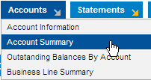
Account Summary
The Account Summary page is used to search for and view summary information about your accounts.
View summary information such as bill total, paid, closed, and outstanding amounts.
Also, view statements and payments associated with an account.
Viewing statements and payments can be done from the Account Summary page. Statements and payments can also be accessed from the Statements and Payments menu options.
To access the Account Summary page, from the menu bar select Accounts > Account Summary.
D9
Notes:
The Account Summary page is used to search for and view a summary of your account balances.

Slide 11
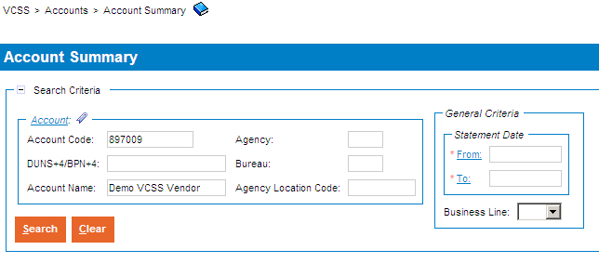
Account Summary (Cont’d)
Account Summary page
The Account Summary page displays with a search criteria area to search for summary information on your accounts.
Enter search criteria and select the [Search] button.
Note: BPN data is not available for many accounts at this time.
D10
Notes:
The Account Summary page displays, with a search area to enter search criteria to search for account summary records.

Slide 12
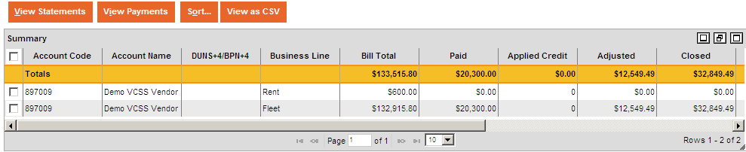
Account Summary (Cont’d)
Account Summary page
In the search results, review your account summary record(s).
Note: The amounts displayed in the search results are what is available in VCSS and restricted by what was entered in the search criteria fields when queried.
D11
Notes:
After running the search for account summary records, review the search results in the search results.
We are now going to review how to view associated statements and payments with an account summary record.

Slide 13
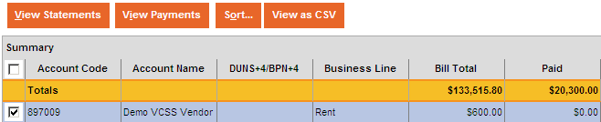
Account Summary (Cont’d)
Account Summary page
To view statements associated with an account summary record, select an account summary record and then select the [View Statements] button.
D12
Notes:
All history will be available for statements and Cash Receipts (CRs).

Slide 14
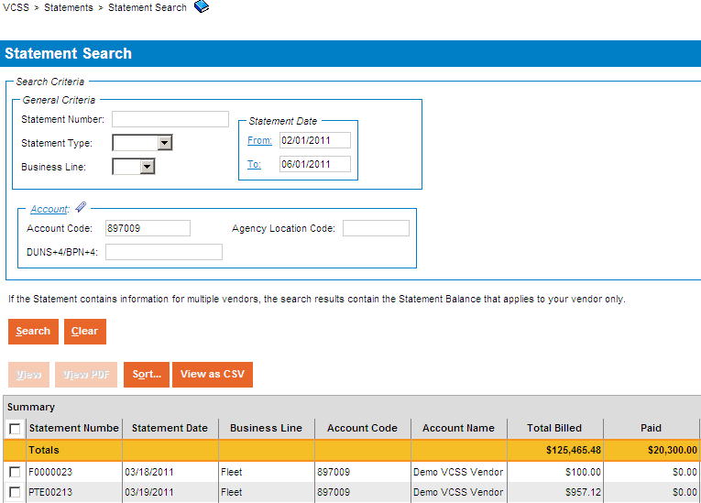
Account Summary (Cont’d)
Statement Search page
The Statement Search page displays with the option to search for statements associated with the selected account summary record.
To search for statement records, enter search criteria and select the [Search] button.
In the search results, review the statement records that display.
D13

Slide 15
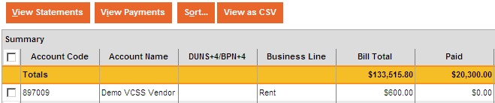
Account Summary (Cont’d)
Account Summary page
To view payments associated with an account summary record, select an account summary record and then select the [View Payments] button.
D14
Notes:
Payment Authorizations (IPs) will only be available from when the customer was registered.

Slide 16
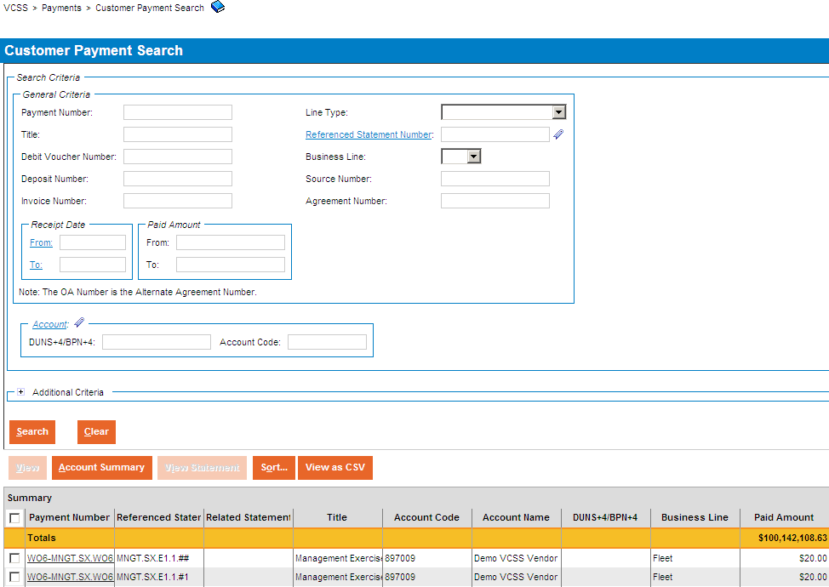
Account Summary (Cont’d)
Payment Search page
The Payment Search page displays with the option to search for payments associated with the selected account summary record.
To search for payment records, enter search criteria and select the [Search] button.
In the search results, review the payment records that display.
D15
Notes:
The Payment Search page displays where you can search for payments associated with the selected account summary record.

Slide 17
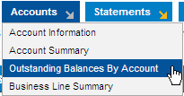
Outstanding Balances by Account
The Outstanding Balances by Account page is used to review outstanding balances for your accounts.
View outstanding balances, such as chargeback amounts and credit amounts.
View outstanding statements.
“Outstanding statements” are statements with an outstanding or unpaid balance greater than $0.
View recent statements.
“Recent statements” are statements from within the last three months.
Also, create account correspondence to send to GSA.
Account correspondence are messages regarding a general issue or question on your account. This correspondence should not be related to a specific statement, refund or payment on your account because there are specific types of correspondence that should be created for these.
To access the Outstanding Balances by Account page, from the menu bar select Accounts > Outstanding Balances by Account.
D16

Slide 18
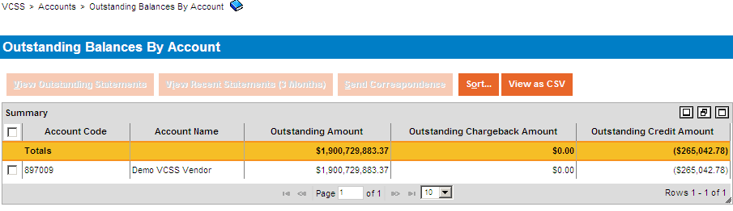
Outstanding Balances by Account (Cont’d)
Outstanding Balances by Account page
The Outstanding Balances by Account page displays, with a list of your account(s) by outstanding balance.
The Outstanding Amount column is the total outstanding amount of statements.
The Outstanding Chargeback column is for IPAC statements only that have been charged back.
The Outstanding Credit Amount column is outstanding credits the customer has.
D17
Notes:
The Outstanding Amount column is the total outstanding amount of statements. The Outstanding Chargeback column is for IPAC statements only that have been charged back. The Outstanding Credit Amount column is outstanding credits the customer has.
We are now going to review the options on this page.

Slide 19
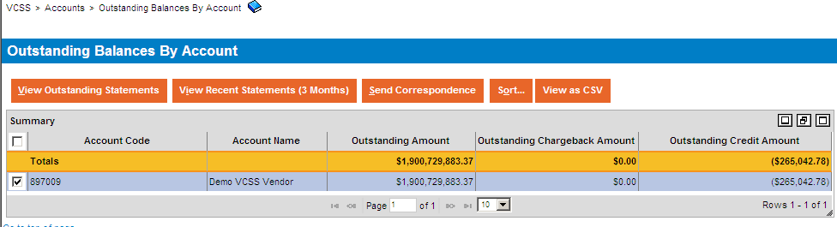
Outstanding Balances by Account (Cont’d)
Outstanding Balances by Account page
To view outstanding statements on your account, select an account record and then select the [View Outstanding Statements] button.
D18
Notes:
Outstanding statements are statements with an outstanding amount greater than $0.

Slide 20
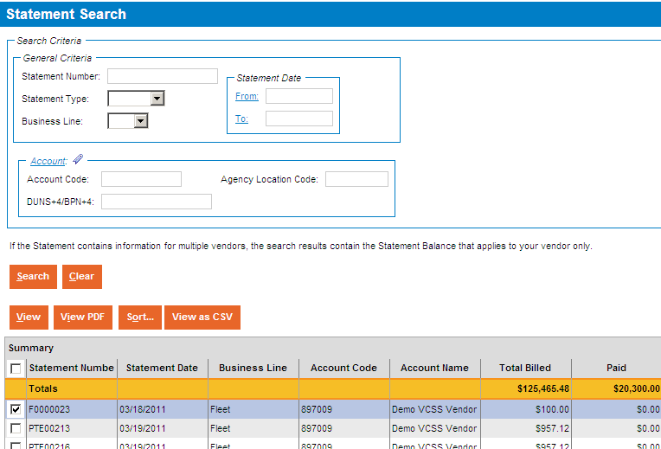
Outstanding Balances by Account (Cont’d)
Statement Search page
The Statement Search page displays with outstanding statement records already shown in the search results.
From this page you can select a statement record and then:
Select the [View] button to view the statement details, or
Select the [View PDF] button to view a PDF version of the statement.
D19

Slide 21
Outstanding Balances by Account (Cont’d)
Outstanding Balances by Account page
To view recent statements on your account, select an account record and then select the [View Recent Statements (3 Months)] button.
D20
Notes:
Recent statements are statements from within the last three months.

Slide 22
Outstanding Balances by Account (Cont’d)
Statement Search page
The Statement Search page displays with recent statement records in the search results.
From this page you can select a statement record and then select the [View] button to view the statement details or select the [View PDF] button to view a PDF version of the statement.
D21

Slide 23
Outstanding Balances by Account (Cont’d)
Outstanding Balances by Account page
To create correspondence to send to GSA, in the search results select an account record and then select the [Send Correspondence] button.
D22
Notes:
From here, you can create correspondence to send to GSA regarding a general issue or question on one of your accounts.

Slide 24
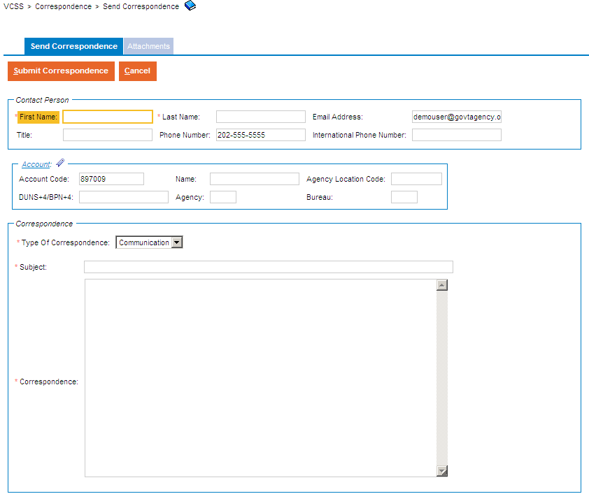
Outstanding Balances by Account (Cont’d)
Send Correspondence page
The Send Correspondence page displays. To send correspondence to GSA, fill out the following information:
Your contact, account, and correspondence information.
Add an attachment, if needed (file types supported are text, PDF, Microsoft Excel and Word documents).
Select the [Submit Correspondence] button to send the correspondence to GSA. Once submitted, GSA will receive and review this correspondence.
D23
Notes:
The Send Correspondence page displays where you can enter the correspondence information, and some fields may automatically default.
In the Contact Person fields you enter your contact information.
In the Account fields enter your account information.
In the Correspondence fields enter your message.
Add an attachment to support your correspondence, if needed.
When you are ready to send your correspondence to GSA, select the [Submit Correspondence] button.
We will cover how to create and send account correspondence in more detail in the Correspondence section of this presentation.

Slide 25
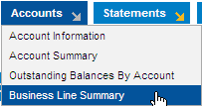
Business Line Summary
The Business Line Summary page is used to search for and view balances for your accounts, with data grouped by the business lines in GSA.
View business line balances, such as total statement amounts, paid amounts, outstanding amounts, and credit amounts.
Also, view statements and payments associated with a business line summary record.
To access the Business Line Summary page, from the menu bar select Accounts > Business Line Summary.
D24

Slide 26
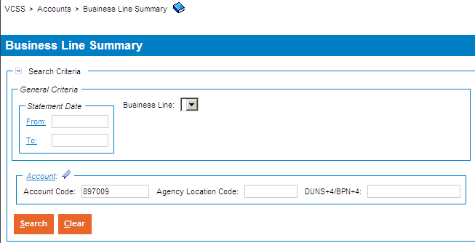
Business Line Summary (Cont’d)
Business Line Summary page
The Business Line Summary page displays with a search criteria area to search for account records sorted by business line.
Enter search criteria and select the [Search] button.
D25
Notes:
The Business Line Summary page displays, with a search area to enter search criteria to search for business line summary records.

Slide 27
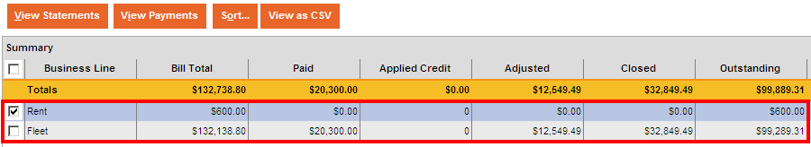
Business Line Summary (Cont’d)
Business Line Summary page
In the search results, review the list of business line summary records.
D26

Slide 28
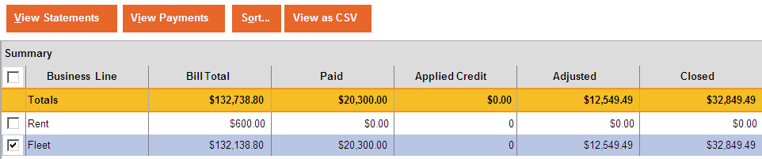
Business Line Summary (Cont’d)
Business Line Summary page
To view statements for a business line summary record, select a business line summary record and then select the [View Statements] button.
D27
Notes:
To review statements for a business line summary record, select the [View Statements] button.

Slide 29
Business Line Summary (Cont’d)
Statement Search page
The Statement Search page displays with statement records in the search results.
From this page you can select a statement record and then select the [View] button to view the statement details or select the [View PDF] button to view a PDF version of the statement.
D28
Notes:
The Statement Search page displays with statement records in the search results.

Slide 30
Business Line Summary (Cont’d)
Business Line Summary page
To view payments made to GSA for a business line summary record, select a business line summary record and then select the [View Payments] button.
D29
Notes:
To review payments associated with an account business line summary record, select the [View Payments] button.

Slide 31
Business Line Summary (Cont’d)
Payment Search page
The Payment Search page displays. To search for payment records, enter search criteria and select the [Search] button. In the search results, review the payment records.
From this page you can select a payment record and then select the [View] button to view the payment details.
D30
Notes:
The Payment Search page displays with payment records pre-populated in the search results.

